Slide 1


Weather Forecasting for Pune Region
Ameya Pardhi 240343025004
Sakshi Bidwai 240343025010
Dhanvantari Warekar 240343025012
Gagan Bajoria 240343025014
Guided By:
Ms. Trupti Joshi
Mr. Prasad Deshmukh

Slide 2
PROBLEM STATEMENT
ABSTRACT
DATASET
SYSTEM ARCHITECTURE
MACHINE LEARNING
LINEAR REGRESSION
RANDOM FOREST
DECISION TREE XGBOOST HOLT WINTER
RESULTS
OUTPUTS
CONCLUSION
FUTURE SCOPE
01
02
03
04
TABLE OF CONTENTS
05
06
07
08
00

Slide 3

Problem Statement
The task is to forecast the temperature in
Pune, India, using historical weather data. This is a regression problem focused on predicting a continuous variable. The dataset comprises past temperature readings and other pertinent features such as humidity and wind speed to assist in forecasting weather conditions.

Slide 4
Abstract :
Accurate weather prediction is essential for sectors like agriculture and disaster management.
Traditional methods often struggle with the complexity of atmospheric conditions, leading to less precise forecasts.
This project addresses the challenge by using machine learning models Linear Regression, Decision Trees, and Random Forests for prediction, alongside the Holt-Winters method for time-series forecasting.
These models analyze large datasets, including historical and real-time weather data, to improve accuracy. The use of the Holt-Winters method further refines forecasts by accounting for seasonality and trends.
This approach has enhanced the precision of short-term and seasonal weather forecasts, aiding better decision-making and preparedness in weather-sensitive industries.

Slide 5
Dataset:
The Pune Region Dataset contains 52,583 entries and 23 columns. Here are the key details:
Column Overview:
date_time: Timestamp for each record.
maxtempC: Maximum temperature in Celsius.
mintempC: Minimum temperature in Celsius.
sunHour: Hours of sunshine.
uvIndex: UV index value.
moon_illumination, moonrise, moonset, sunrise, sunset: Various astronomical data.
DewPointC, FeelsLikeC, HeatIndexC, WindChillC: Various temperature-related indices.
WindGustKmph, cloudcover, humidity, precipMM, pressure, tempC, visibility, winddirDegree, windspeedKmph: Various meteorological variables.

Slide 6
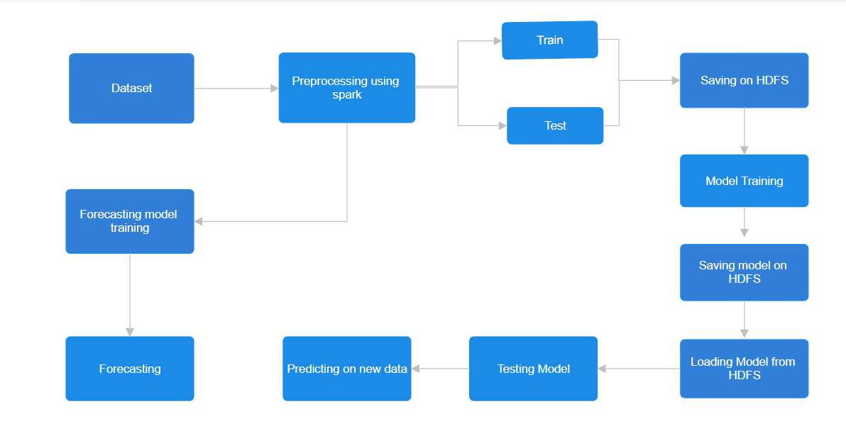
System Architecture:

Slide 7
Architecture Details:
ETL Processes:
Used Apache Spark for efficient ETL.
Data Storage:
Stored in HDFS for scalable and fault-tolerant storage.
Machine Learning Models:
Applied Random Forest, XGBoost, and Decision Tree for weather prediction.
Time-Series Forecasting:
Utilized Holt-Winter for accurate temperature forecasting.
Performance:
High accuracy and reliability demonstrated.

Slide 8
Linear Regression:
Algorithms
A Linear Regression model predicts a continuous target variable by finding the linear relationship between the input features and the target.
Model Parameters:
maxIter: 50 (number of iterations for optimization).
regParam: Regularization parameter (values tested: [0.01, 0.1, 0.5]).
elasticNetParam: ElasticNet mixing parameter (values tested:[0.0, 0.5, 1.0]).
Best Model Hyperparameters:
- regParam: 0.01
- elasticNetParam: 1.0
Used Cross-Validation: 3-fold cross-validation to tune the hyperparameters.

Slide 9
Decision Tree:
Algorithms
A Decision Tree Regression model predicts continuous values by creating a tree-like structure that splits the data based on feature values to make predictions.
Model Parameters:
maxDepth : Maximum depth of the tree (values tested: [5, 10, 15]).
minInfoGain : Minimum information gain required to split a node
(values tested : [0.0, 0.01]).
Best Model Hyperparameters:
-maxDepth : 5
-minInfoGain : 0.0
Used Cross-Validation: 3-fold cross-validation to tune the hyperparameters.

Slide 10
Random Forest:
Algorithms
A Random Forest Regressor, an example of ensemble learning, combines multiple decision trees to improve prediction accuracy and robustness by averaging their outputs to make final predictions.
Model Parameters:
numTrees: Number of trees in the forest (values tested: [10, 20]).
maxDepth: Maximum depth of each tree (values tested:[5, 10]).
minInfoGain: Minimum information gain required for a split
(values tested:[0.0, 0.01]).
Best Model Hyperparameters:
-numTrees: 20
-maxDepth: 10
-minInfoGain: 0.01

Slide 11
XGBoost :
Algorithms
XGBoost is a powerful ensemble learning method that combines the predictions of multiple decision trees to improve accuracy and handle complex patterns in data.
Model Parameters:
Maxdepth : Maximum depth of a tree(values tested: [3, 5]).
Learning rate : Step size shrinkage used to prevent overfitting.
(values tested:[0.05, 0.1]).
Gamma : Minimum loss reduction required to make a further partition on a leaf node. (values tested:[0, 0.1])
Best Model Hyperparameters:
-gamma: 0.1 -learning rate: 0.1
-max depth: 5

Slide 12
Holt Winter:
Algorithms
A powerful forecasting method that captures underlying trends and seasonal effects. It provides flexible options for modeling seasonal patterns and trends
Model Parameters:
Trend Component: Additive / Multiplicative
Seasonal Component: Additive / Multiplicative
Seasonal Periods: 24
Damped Trend: False(No damping)
Initialization Method: Estimated
Best Model Hyperparameters:
-trend : Additive
-seasonal : Multiplicative

Slide 13
Results:
Model | Before Hyperparameters |  |  | After Hyperparameters
 | MAE | RMSE | R-Sqr | MAE | RMSE | R-Sqr
Linear Regression | 0.960 | 2.020 | 0.800 | 0.960 | 2.030 | 0.800
Decision Tree | 0.900 | 1.910 | 0.820 | 0.900 | 1.910 | 0.820
Random Forest | 0.830 | 1.890 | 0.830 | 0.610 | 1.760 | 0.850
XGBoost | 0.620 | 1.820 | 0.840 | 0.590 | 1.730 | 0.857

Slide 14
Results:
Model | Before Hyperparameters |  |  | After Hyperparameters
 | AIC | MAE | RMSE | AIC | MAE | RMSE
Holt-Winter(Additive) | -25596 | 6.3 | 7.4 | -25589 | 6.7 | 7.9
Holt-Winter(Multiplicative) | -26151 | 6.5 | 7.8 | -26157 | 5 | 6.1

Slide 15
Conclusion:
Successful Model Development: Developed a machine learning model that forecasts temperatures with reasonable accuracy based on historical weather data.
Data Processing and Analysis: Demonstrated effective data preprocessing, feature selection, and model training techniques.
Valuable Insights: Provides valuable insights into future temperature trends in Pune.
Impact on Stakeholders: Aims to assist stakeholders in climate-sensitive sectors such as agriculture, tourism, and infrastructure development with improved decision-making.
Addressing Climate Challenges: Contributes to efforts in mitigating the impacts of climate
variability and advancing understanding of regional climate dynamics.

Slide 16
Future Scope:
High-Resolution Data Integration: Integrate high-resolution data from various sources for improved prediction accuracy.
ETL Processing with Apache Airflow: Use Apache Airflow to streamline ETL processes and improve data pipeline management.
Advanced Feature Engineering and Deep Learning: Explore further feature engineering and implement deep learning architectures for enhanced model performance.
Uncertainty Estimation and Localized Predictions: Develop methods for estimating uncertainty and making localized predictions.
Decision Support Integration: Integrate the model with decision support systems for urban planning and disaster management.

Slide 17
THANK
YOU !!

